Slide 1
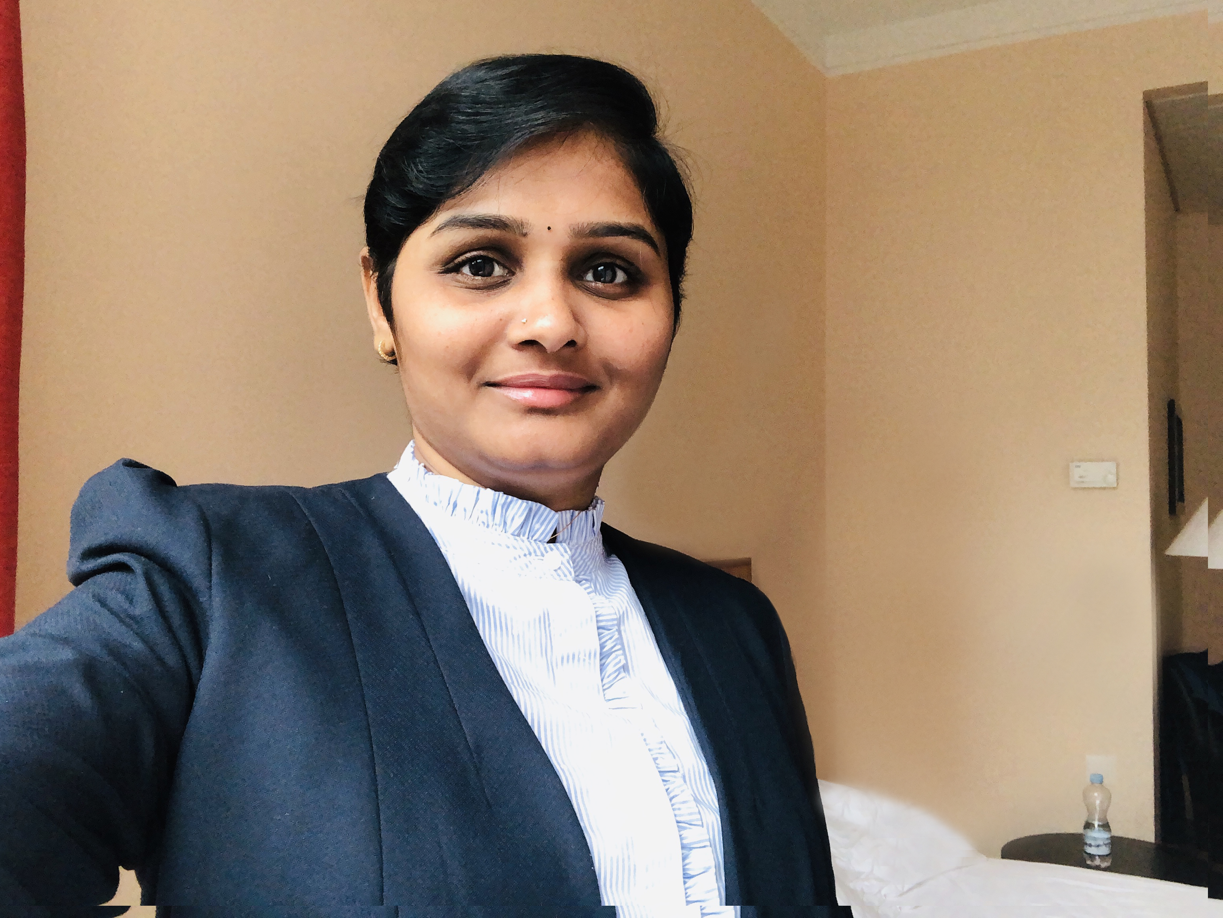
Sudharani Challa
+91 8978905566
UX/UI Lead & SDM
challa.sudharani@gmail.com
www.linkedin.com/in/sudhachalla
www. sudhachalla.gitbub.io
I am focused on creating meaningful experiences through design.
Education
Masters in Communication & Journalism (MCJ)
Over 16+ years of insightful experience in user interface and experience designing, managing and delivering digital transformations, applications and legacy systems. A creative designer with a passion for perfection, experience with user Interface design, UX specs, task flows, wireframes, info graphics, storyboards, mockups, prototypes, visual design and design patterns.
Padmavati Mahila Viswa Vidyalayam, Tirupati
2004 - 2006
Oct 2016 to till date
BA
Associate Director –Solution Delivery & UX, Novartis Health Care Pvt. Ltd.
Andhra University, Visakhapatnam
Established UX design as the first stage of all Web and mobile application developments, instituting a user-centered design (UCD) approach.
Designed high-impact, user-centered Web sites with strong emotional appeal, sophisticated production values and intuitive navigation to maximize user engagement and powerful brand identities.
Researched, strategized and launched UX improvements for STRIDE, Motion and Ambition Programs.
Developed and implemented UX strategies and guidelines to ensure consistent and cohesive user experiences across multiple platforms.
Created wireframes, prototypes, and user flows to effectively communicate design concepts and interactions.
Facilitated workshops and design sprints to ideate and iterate on design solutions. Provided mentorship and guidance to team members, fostering a collaborative and creative work environment
2001 – 2004
Skills
User Research
Wireframing &
Prototyping
Usability Testing
Interaction Design
Design Thinking
Information Architecture
Visual Design
Project Management
Team Leadership
Stakeholder Collaboration
Agile Methodologies
Risk Management
Team Leadership
Problem Solving
Led a team of delivery specialists in the successful delivery of multiple software projects, ensuring adherence to project timelines, budgets, and quality standards.
Collaborated with cross-functional teams including development, testing, and product management to define project scope, requirements, and deliverables.
Implemented Agile methodologies and best practices, resulting in project efficiency and customer satisfaction.
Managed stakeholder expectations and provided regular project status updates, ensuring transparency and effective communication throughout the project lifecycle.
Specialist-UX - Verizon Data Services India Ltd.
Apr 2012 to Oct 2016
Coordinating with marketing team to create user centric interface for Broadband portal, AppFinder and verizonwireless.com.
Redesigning the portal to simplify the User Experience.
Developing the cross browser and user centric frontend using html5 and bootstrap.
Developing a responsive layout using bootstrap which can be scalable to any devise irrespective of the size.
Designing wireframes, icons and graphics.
Creating product promotional email templates and sending across clientele
Technologies
Figma, Adobe XD, Sketch, Invision, Photoshop, HTML, CSS3, Bootstrap, JQuery, PPT
Dec 2010 to Mar 2012
Graphic & Web designer - Gyan Web Solutions
Certifications
Designed the entire product end to end, from the logo to all the pages.
Understand the process flow of the application and created wireframes and prototypes for all modules.
Written test cases for all the modules.
Converted the templates into html prototypes.
Managed all scheduled jobs; including testing, staging and Monitoring.
Designed the marketing collaterals like brochures, holders, leaflets, newsletters etc..
Leadership Program from IIM Bangalore.
Jan – Dec 2019
Jun 2008 to Dec 2010
Awards
Content Writer & Graphic designer - Creative Technosoft Systems
Gold Medal in Masters (MCJ)
Redesigned user Interface and created brand identity for CTS website.
Designed in-house application named as CTS Desk.
Designed and developed content for Marketing Collaterals (Brochures, Ads, Business Presentations, flash presentations etc.)

